Slide 1


Loan Default Prediction
How advanced machine learning algorithms can help reduce loan defaults.

Slide 2
1.1 AGENDA
1
Recap
11:30 a.m. – 11:35 a.m.
2
Logistic Regression
11:35 a.m. – 11:40 a.m.
3
Testing Hypothesis
11:40 a.m. – 11:50 a.m.
4
Project Management
11:55 a.m. – 12:00 p.m.
5
Next steps
12:00 p.m. – 12:05 p.m.

Slide 3

1.0 RECAP
Data Cleaning
Outlier Analysis
Data Imputation
Feature Selection
Recap
discussed the baseline model.
did about data imputation.
Various feature selection method & their outputs.

Slide 4
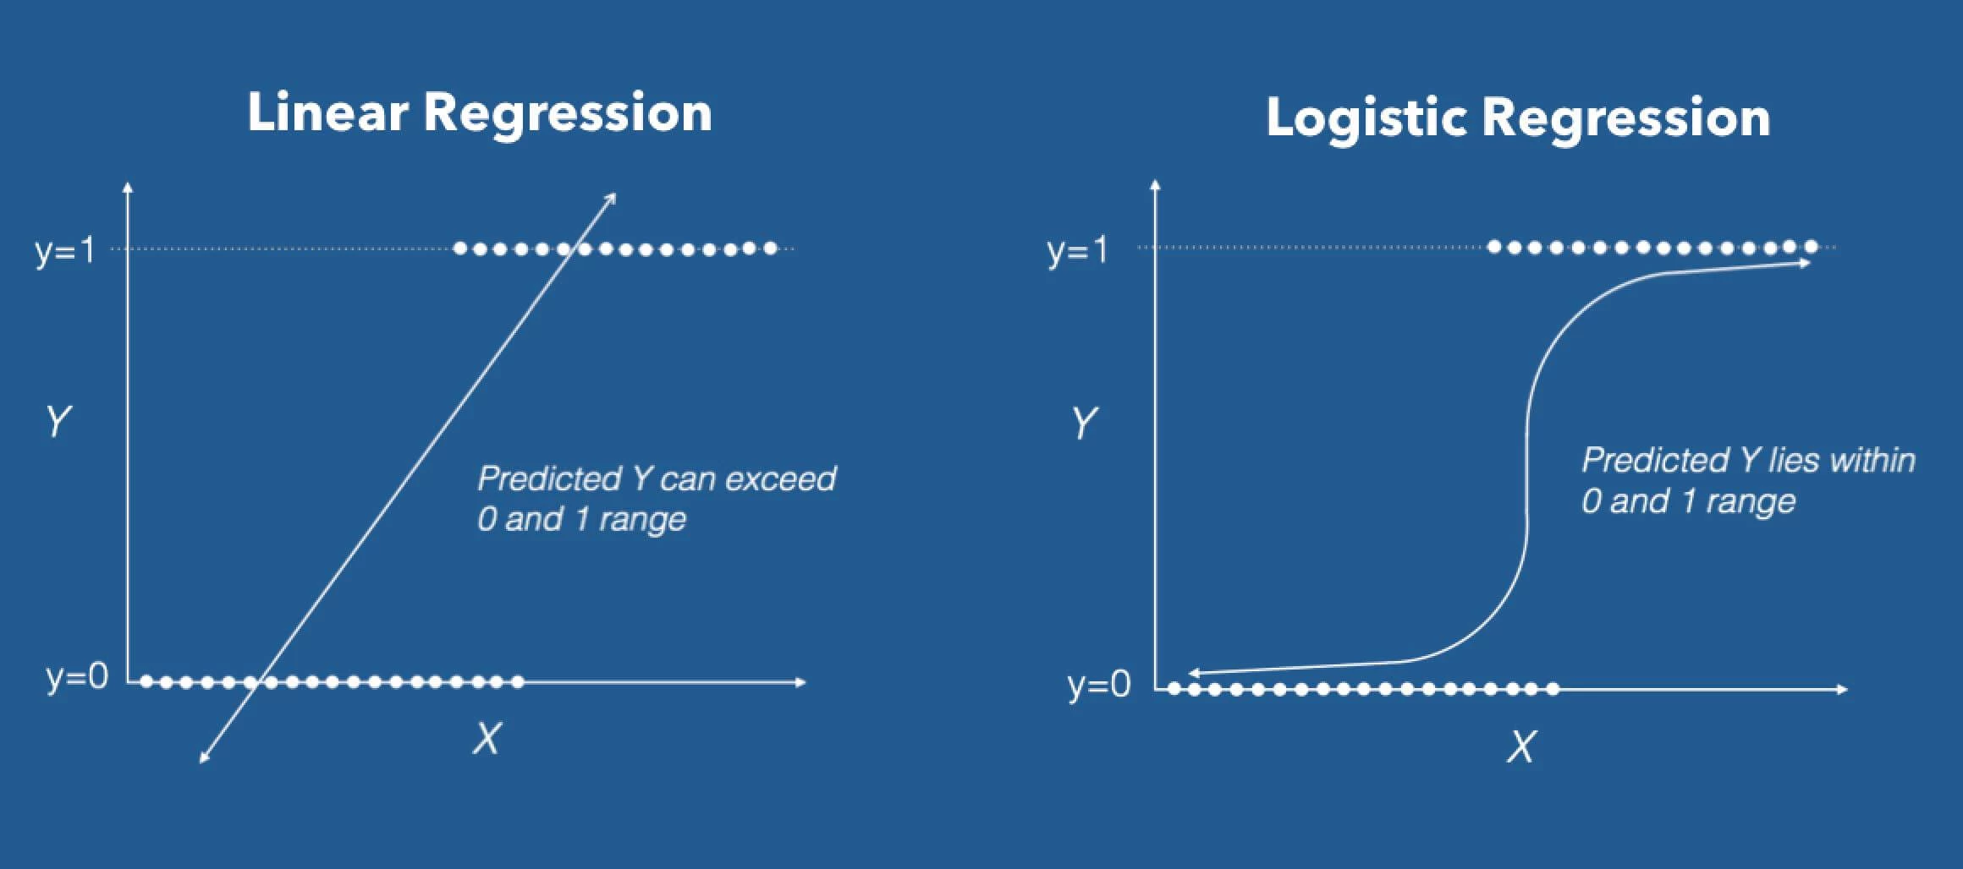
2.1 LOGISTIC REGRESSION
Why did we choose logistic regression ?
Dichotomous target variable.
Based on probability of each observation towards class A or B.
Probability threshold (default is 0.5) can be changed to improve prediction.
Benchmark for further complex models.
1
2
But why ?
3
4
Assumption
1
The dependent variable should be dichotomous in nature.
There should be no outliers in the data.
There should be no high correlations (multi-collinearity) among the predictors.
2
3

Slide 5
2.2 LOGISTIC REGRESSION
Pro’s & con’s of logistic regression.
PROS
Output is based on probability, makes classification easier.
Classification threshold can be adjusted from default 50%.
Independent variables need not be normally distributed.
Easy to implement, efficient to train, less computational time.
CONS
Doesn’t perform well when feature space is too large (overfitting).
Not fit for non-linear features. Needs transformations.
Outcome is more stable with large sample size.
Easily outperformed by complex algorithms.
Notes:
The most important point is that Logistic Regression is a parametric method and the out is more interpretable than any other method e.g. random forest etc... plus requires less data to train compared to non-parametric methods

Slide 6
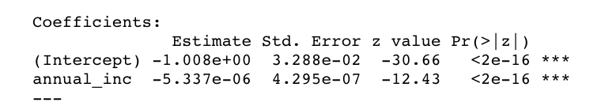
2.3 LOGISTIC REGRESSION
How does logistic regression works ?
Logistic Regression Model measures probability that Y belongs to a particular category.
LR uses maximum likelihood estimation.
Since log-odds (logit) is used for scaling, values can be only between 0 and 1.
Logistic Regression measures Regression Coefficients (correlation of IV to DV).
Assumptions; dependent variable to be ordinal, independent variables (features) should not be too highly correlated and no outlier sensible
Example
Let´s fit a model an estimate the probability of default of a customer which annual income is $10,000
e -1.008e+00 - 5.337e-06*10000
1+e-1.008e+00 + 5.337e-06*10000
p(X) =
=
0.563
In this case the probability of default is 56% hence this customer is classified as defaulted .
Notes:
The most important point is that Logistic Regression is a parametric method and the out is more interpretable than any other method e.g. random forest etc... plus requires less data to train compared to non-parametric methods

Slide 7

3.1 FITTING A LOGISTIC REGRESSION MODEL USING mRMR
Main KPI to optimize Specificity
Secondary KPIs to improve if possible Sensitivity
We used a simple CV with split of train and test and validate with the test
Split is 60 for training and 40 for testing

Slide 8
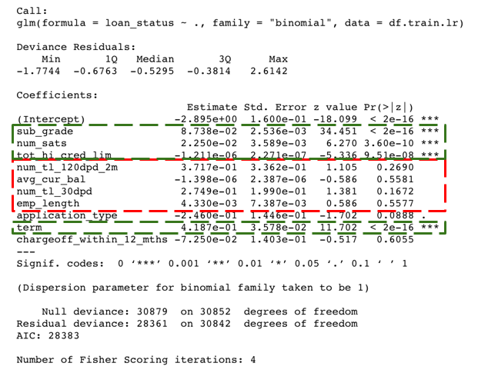
3.2 FITTING A LOGISTIC REGRESSION MODEL USING mRMR
For each variable the regressions coefficients are estimated (Estimate) and are use to estimate the probability of default.
Analysing the p-values, we can see that some variables are not statistically significant (red). The lowest p-value of some variables (green) is suggesting a strong association with the probability of defaulting.
Source; https://www.r-bloggers.com/how-to-perform-a-logistic-regression-in-r/
Fully paid = 0
Charged off = 1

Slide 9
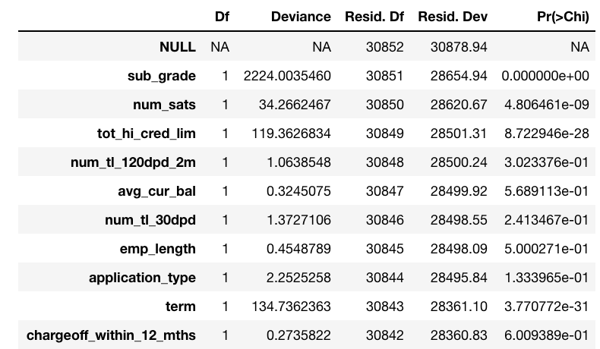
3.3 FITTING A LOGISTIC REGRESSION MODEL USING mRMR
Also, we want to analyze the table of deviance of our model, to get better inside on the variables added:
The difference between the deviance and the residual deviance shows how our model is doing against the null model (a model with only the intercept),
The higher the gap, the better, in this case we see which features has a big influence on our model (sub_grade num_sats and tot_hi_cred_lim)
Fully paid = 0
Charged off = 1

Slide 10

3.4 FITTING A LOGISTIC REGRESSION MODEL USING mRMR
We made predictions on the training set to evaluate. We should always predict on unseen observations (test or validation) but here we want to get an idea of the perfect threshold to be use hence predict on train set.
0 -> 0.186279138483542
1 -> 0.281054641759347
We estimated the average probability of prediction in
0 (fully paid) and 1 (charged off):
This already gave us an idea that our model is good predicting fully paid but not that good predicting charged off, most like this is due to the imbalance dataset.
Ideally we will decrease the threshold (or cut-off) for example to 0.4 or 03 which will improve the prediction on 1 but decrease the prediction on 0
Fully paid = 0
Charged off = 1

Slide 11


3.5 BUSINESS PRESPECTIVE TO LOGISTIC REGRESSION
After doing some analysis we came up with the following insights that we consider valuable for one of our stakeholder (Risk Department) at Lending Club. Seems like the following metrics has strong association with defaulting applications:
LC assigned loan subgrade
Number of satisfactory accounts
Total high credit/credit limit
The number of payments on the loan. Values are in months and can be either 36 or 60.
On the other hand, we find out that some variable (oddly enough) seems like they are not statistically significant, hence not that relevant for the model:
Employment length in years
Average current balance of all accounts

Slide 12
3.6 COMPARISON OF VARIOUS FEATURE SELECTION METHOD
Which Feature Method perform better?
Main KPI to optimize Specificity
Secondary KPIs to improve if possible Sensitivity

Slide 13
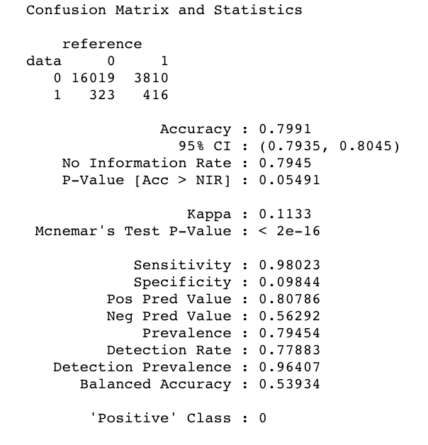
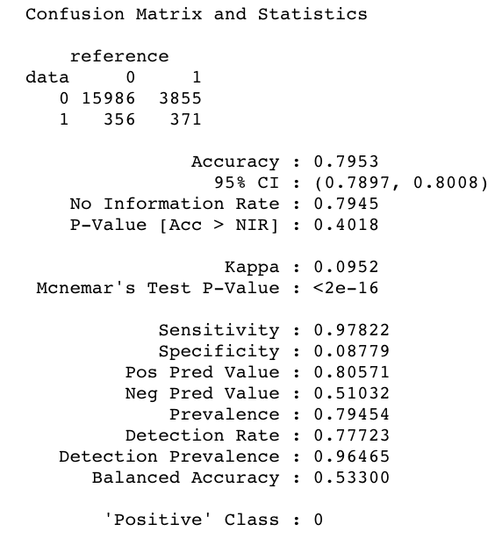
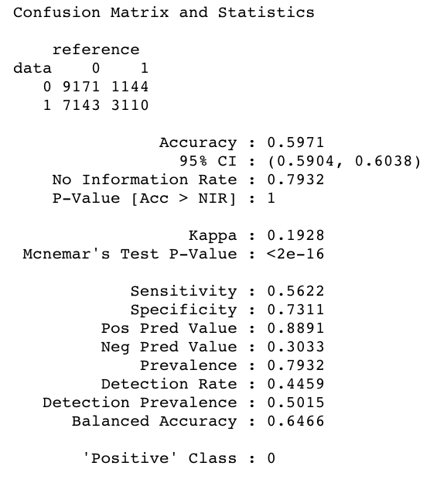
3.7 LOGISTIC REGRESSION USING FEATURES FROM RELIEFF
Relieff with correlated features
Relieff without correlated features
Relieff without correlated features and weight classes
Fully paid = 0
Charged off = 1

Slide 14
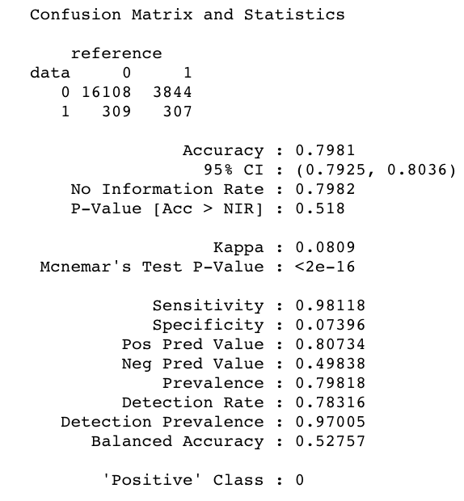
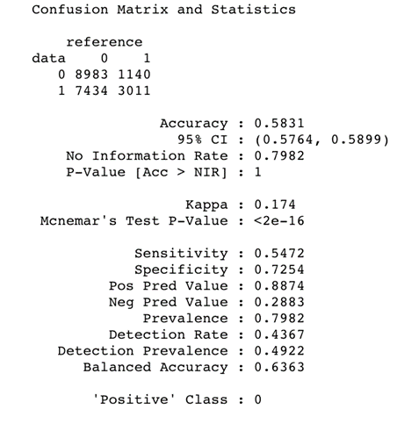
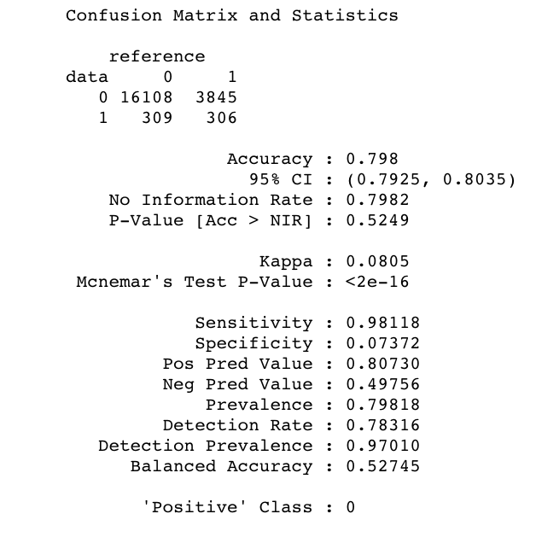
3.8 LOGISTIC REGRESSION USING FEATURES FROM GAIN RATIO
GainRatio with correlated features
GainRatio without correlated features
GainRatio without correlated features and weight classes
Fully paid = 0
Charged off = 1

Slide 15

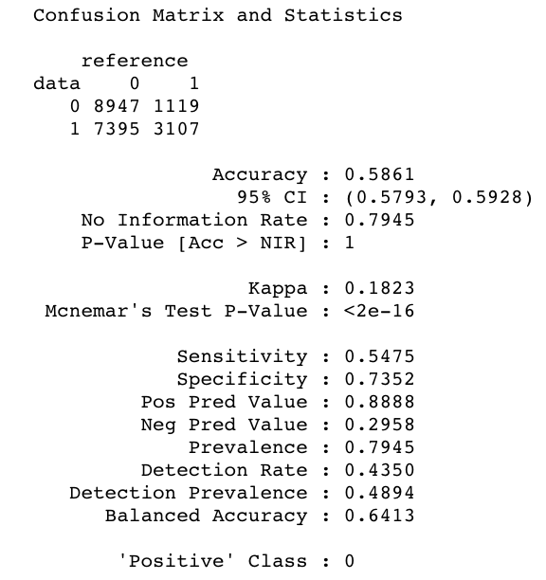
3.9 LOGISTIC REGRESSION USING FEATURES FROM mRMR
mRMR
mRMR and weight classes
Fully paid = 0
Charged off = 1

Slide 16
3.10 LOGISTIC REGRESSION USING FEATURES FROM mRMR
Conclusions based on findings
mMRM with class weight performed the best is we consider specificity (0.7352) compared with Relief (0.7311) and GainRatio (0.7254)
We select mRMR as the best performing feature selection method in combination with class weight

Slide 17
3.11 LOGISTIC REGRESSION USING mRMR & KNN
Does KNN an impact of the model KPIs?
Main KPI to optimize Specificity
Secondary KPIs to improve if possible Sensitivity
We used KNN 4 and KNN 6
We also considered the computational time as a measure

Slide 18
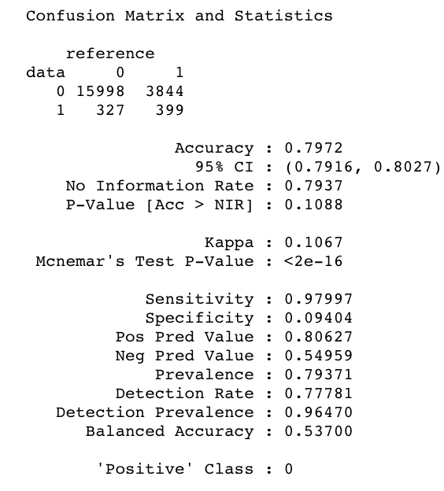
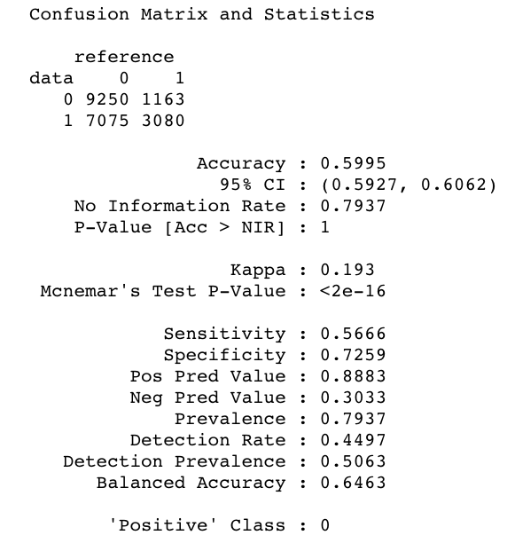
3.12 LOGISTIC REGRESSION USING mRMR & KNN
mRMR KNN4
mRMR and weight classes & KNN4
Computational time KNN -> executed in 18m 06s, finished 17:28:05 2018-11-07
KNN altered the ranked featured on mRMR
Fully paid = 0
Charged off = 1

Slide 19
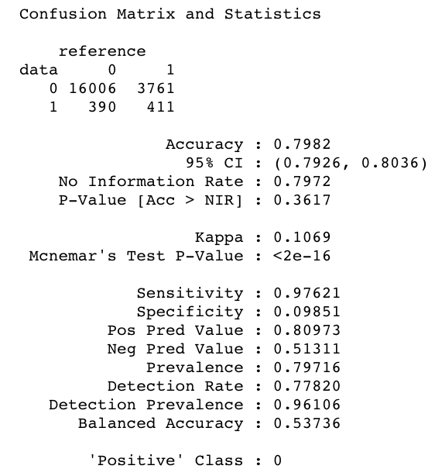

3.13 LOGISTIC REGRESSION USING mRMR & KNN
mRMR KNN6
mRMR and weight classes & KNN6
Computational time KNN -> executed in 21m 12s, finished 17:02:24 2018-11-07
KNN(6) altered the ranked featured on mRMR also the ranked by KNN(4)
Fully paid = 0
Charged off = 1

Slide 20
3.14 LOGISTIC REGRESSION USING mRMR & KNN
Conclusions based on findings
The higher neighborhood (k) increase the computation time. KNN 4 was executed in 18m 6s and KNN 6 was executed in 21m 12s
KNN 6 and KNN 4 showed better Acc for mRMR without weighted class
KNN 6 and KNN 4 showed the same specificity for mRMR with weighted class but worst specificity compared to mean imputation for mRMR with weighted class
KNN does not improve specificity for mRMR using Logistic Regression but no assumptions made about other classification algorithm e.g. same performance while using Random Forest
Interesting finding; KNN altered the features selected by mRMR

Slide 21
3.15 ADDING MORE FEATURES FROM mRMR IMPROVE RESULTS?
Main KPI to optimize Specificity
Secondary KPIs to improve if possible Sensitivity
We added +10 more features based on the mRMR ranking (total 20 features ranked by mRMR)

Slide 22

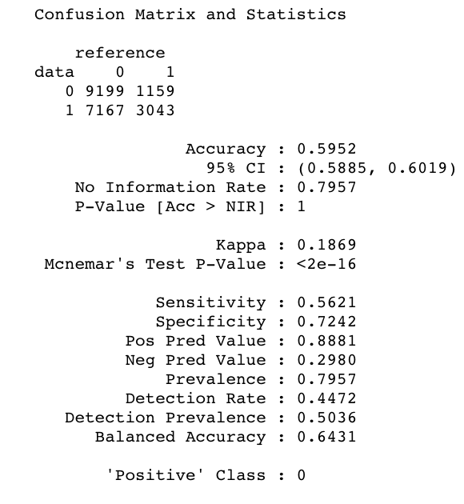
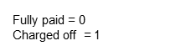
3.16 ADDING MORE FEATURES FROM mRMR IMPROVE RESULTS?
Logistic Regression using features from mRMR +10 features
mRMR features
mRMR weight classes

Slide 23
3.17 ADDING MORE FEATURES FROM mRMR IMPROVE RESULTS?
Conclusions based on findings
The overall Accuracy is 0,592 vs 0,586.
Specificity is 0.724 vs 0.732 which is worse compared to mRMR adding only 10 features

Slide 24
3.18 DOES SCALING IMPROVE RESULTS?
Main KPI to optimize Specificity
Secondary KPIs to improve if possible Sensitivity
We scaled the data to bring all the features to the same “dimension”
Compared with mRMR first results

Slide 25
3.19 LOGISTIC REGRESSION SCALING
mRMR
mRMR & weight classes

Slide 26
3.20 LOGISTIC REGRESSION SCALING
Conclusions based on findings
Same results. The main reason of this is the way the probability is calculated within the logistic regression, where the logit is used to scale the probabilities to limited to 0 or 1.

Slide 27
3.21 INCREASE AMOUNT OF TRAINED DATA
What if we increase amount of trained data with a different split (80/20) ?
Main KPI to optimize Specificity
Secondary KPIs to improve if possible Sensitivity
We scaled the data to bring all the features to the same “dimension”
Compared with mRMR first results
Split is 80 for training and 20 for testing

Slide 28
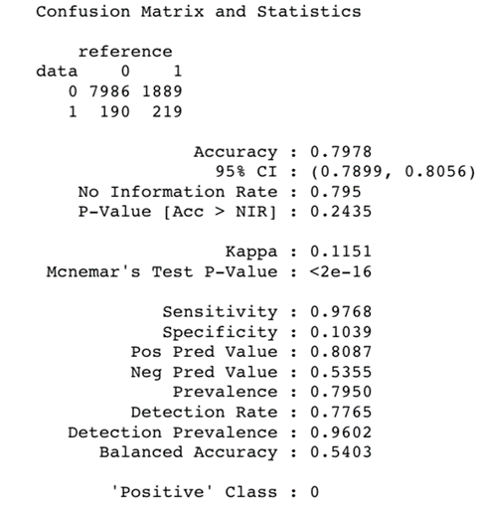
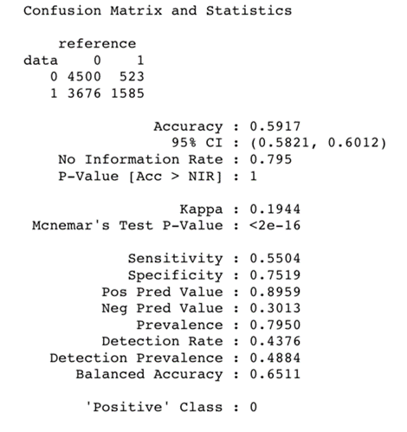
3.22 LOGISTIC REGRESSION USING FEATURES FROM MRMR & SPLIT 80-20
mRMR
mRMR & weight classes

Slide 29
3.23 LOGISTIC REGRESSION USING FEATURES FROM MRMR & SPLIT 80-20
Conclusions based on findings
Seems like this improve accuracy of the model from 0.5861 to 0.5917
Also improve the specificity from 0.73252 to 0.7519

Slide 30
3.24 CHANGE THE THRESHOLD TO IMPROVE THE PREDICTION
What if we change the threshold to improve the prediction on default?
Main KPI to optimize Specificity
Secondary KPIs to improve if possible Sensitivity
We scaled the data to bring all the features to the same “dimension”
Compared with mRMR first results
Split is 80 for training and 20 for testing
Modified the threshold from 0.5 to 0.4

Slide 31
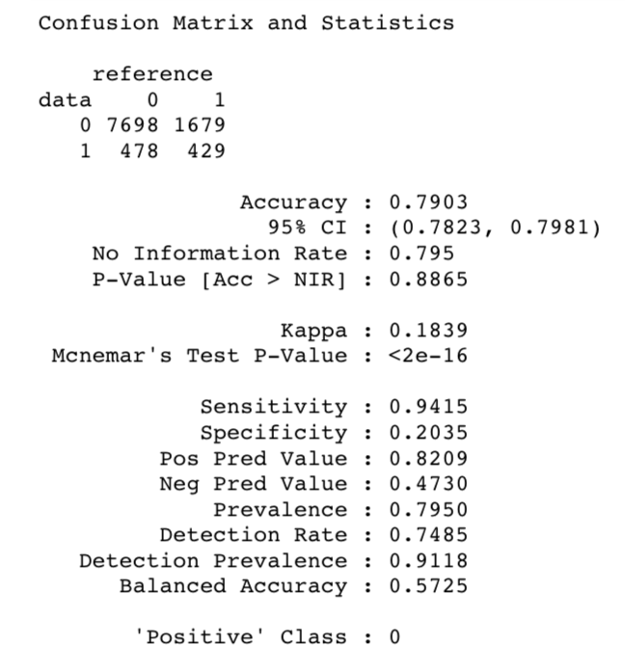
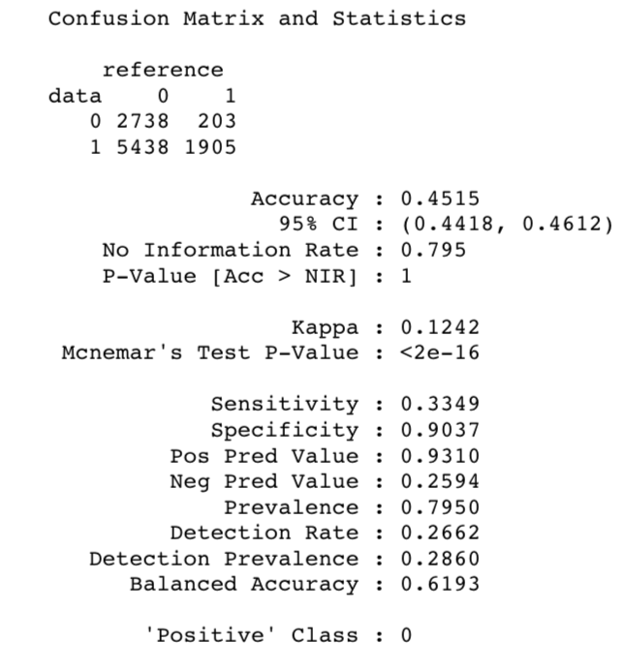
3.25 CHANGE THE THRESHOLD TO IMPROVE THE PREDICTION
mRMR
mRMR & weight classes

Slide 32
3.25 COMPARISION of CONFUSION MATRIX

Slide 33
3.26 BASELINE MODEL VERSUS BEST PERFORMING MODEL
Conclusions based on findings
After different iterations around Logistic Regression and the different features selection method to use we managed to come up with the best possible model in terms in Specificity (we considered 0 as positive hence we should consider Specificity and not Sensibility)
The Baseline model has a Specificity of 50% and our best performing model using logistic regression got a Specificity of 90,37%, which is +40,37 percentage point higher.
Also, in terms of Accuracy, the Baseline model has an Accuracy of 69% and our best performing model using logistic regression got an Accuracy of 45%, which is -24 percentage points lower.
The value for Kappa is 0.12, indicating a poor level of agreement.

Slide 34
4.1 PROJECT MANAGEMENT
A glimpse of our Trello, our project management dashboard.

Slide 35
4.2 PROJECT MANAGEMENT
A glimpse of our Trello, our project management dashboard.
Identified Process Improvement - After first brainstorming session, presentation will be initiated. During this phase a second brainstorming session will be done while finalizing the presentation through online communication.
Created Sprint3 from Nov 7 to Nov 13 with 7 tasks.
Monitored progress of each task and marked "in progress, complete."
Will perform 'Sprint Review Meeting' with customer after Presentation #4 on Nov 14.
Will perform 'Sprint Retrospective Meeting' with Team after 'Sprint Review Meeting' on Nov 14.
Will plan Sprint4 after 'Sprint Retrospective Meeting' on Nov 14.

Slide 36
5.1 NEXT STEPS
In the next we plan to complete the following things
First Iteration to improve model
Feature engineering: One hot encoding & new variable
Consider new feature selection method: RFE and
others
Dealing with Imbalanced dataset: smotefamily and unbalanced packages
Elastic-net and other Non-parametric algorithms

